Slide 1

Stock Market Analysis
Submitted by
Abhishek Bhardwaj
Deepak Pokhriya
Submitted to Mentor Sumit Pandey
Cdac Noida Ms.Sidhidatri Nayak Utkarsh TEwari

Slide 2
Introduction
Problem Statement & Aim:
-------------------------------------------------------------------------------------------------------------------------------
“Analysis of Stock Market and Prediction using LSTM.“
“Our aim is to predict the opening price of a stock for upto 30 or 60 days.“
---------------------------------------------------------------------------------------------------------------------------------------------------------------------
In a world driven by data and finance, understanding market and the stocks is more critical than ever.
Our project aims to provide insights into the dynamic world of stock trading by harnessing the power of data analysis .
Through this presentation, we will take you on a journey into the realms of historical stock data, data Fetching, visualization, and predictive modelling.
We explore the past, make sense of the present, and peek into the future of stock markets using innovative techniques and tools.
By the end of this presentation, you'll gain a deeper understanding of how data-driven analysis can empower investors and financial professionals.
Let's embark on this exciting exploration of the Stock Market Analysis Project.

Slide 3
Project Overview
Our Stock Market Analysis Project is a comprehensive effort to decode the complexities of stock markets and harness their predictive power.
This project is driven by the goal of creating a prototype that can assist investors, traders, and financial analysts in making informed decisions.
Key components of the project include data collection, pre-processing, data Fetching, visualization, and predictive modelling.
Data Collection: We have retrieved historical stock data from a company with an open source APIs to ensure our analysis is based on accurate and up-to-date information.
Database Integration: We have integrated MySQL database into our project to efficiently store and manage the data fetched from the API.
LSTM for Stock Prediction: The LSTM (Long Short-Term Memory) model, a type of recurrent neural network (RNN), is employed to forecast stock prices.
Visualization with Tableau: The power of visualization is harnessed through Tableau, enabling us to present data in an intuitive and insightful manner.

Slide 4
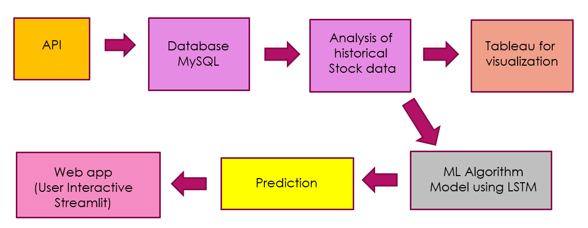
Work Flow Of Our Project

Slide 5
Data Fetch
Data collection is the foundational step of our Stock Market Analysis Project.
To ensure the accuracy and timeliness of our analysis, we obtained historical stock market data from online APIs.
APIs (Application Programming Interfaces) provided us with direct access to real-time and historical stock data from reputable sources.
The use of APIs allowed us to gather data efficiently and systematically, ensuring that our analysis is based on the most current information available.
Through these APIs, we retrieved data from a diverse range of companies and stock exchanges, offering a comprehensive view of the market.
This robust data collection process forms the backbone of our project, enabling us to perform in-depth analysis and provide valuable insights into the stock market's behaviour.
In the subsequent slides, we will delve into the pre-processing and analysis of this collected data, shedding light on the methodologies and techniques employed to extract meaningful patterns and trends.

Slide 6
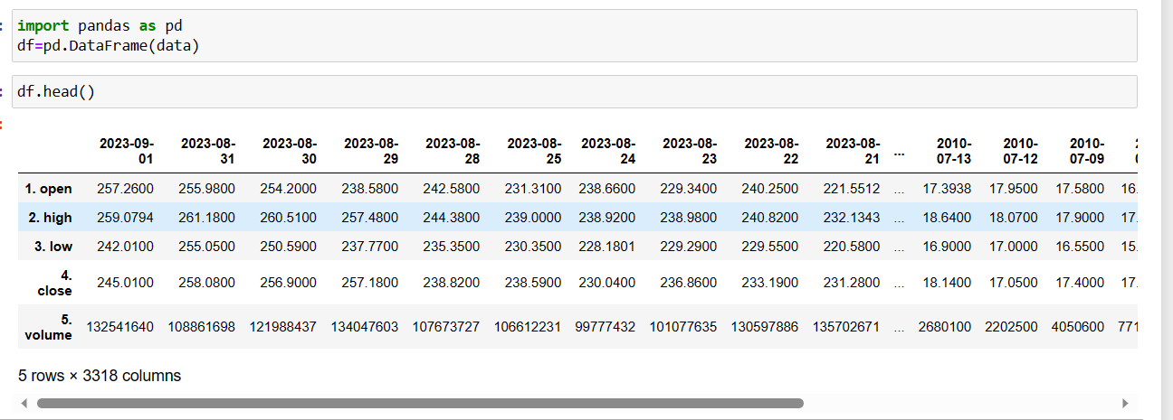

Slide 7
Data Pre-processing and Database Integration
Data pre-processing and storage are essential steps in our Stock Market Analysis Project to ensure that we work with clean and structured data.
To achieve this, we implemented a database integration using Python and MySQL through the pymysql library.
This is an overview of the steps involved in data pre-processing and data insertion:

Slide 8
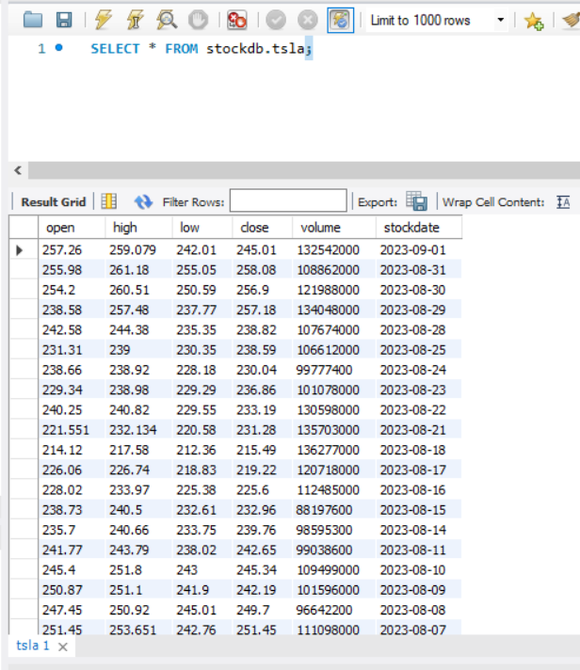

Slide 9
Data Prediction
In this phase of our Stock Market Analysis Project, we employ advanced machine learning techniques to predict future stock prices.
We utilize a custom-built predictive model to forecast stock price movements. here is an overview of the process:

Slide 10
Visualize Prediction Results
In this phase of our Stock Market Analysis Project, we visualize the power of predictive modelling by displaying the forecasted opening prices on a dynamic line graph.
Highlighting the Trend and Fluctuations:
The line graph vividly illustrates the predicted opening prices over a specified time horizon.
We use this graph to highlight trends and fluctuations in the stock's value, offering valuable insights into potential market movements.
The upward and downward movements, peaks, and valleys all provide valuable information for investors and analysts

Slide 11
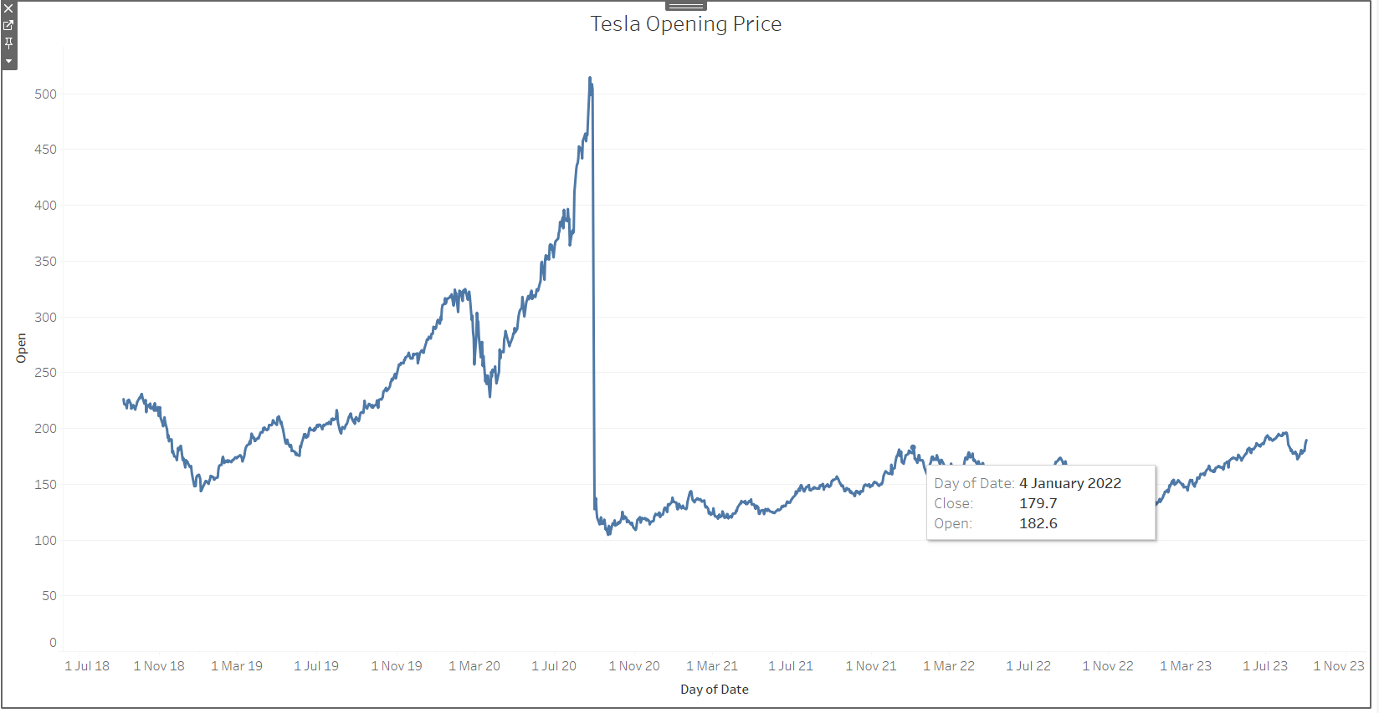

Slide 12
User Interactive Web App
To provide an enhanced user experience and make our Stock Market Analysis Project more accessible, we've incorporated Streamlit, a Python library for creating interactive web applications.
Stock Matrix Visualization: Our Streamlit-powered web application includes a dynamic stock matrix that allows users to select and visualize multiple stocks simultaneously.
Date Range Selection: Users can specify custom date ranges to focus on specific periods of interest. This flexibility enables detailed analysis of stock trends over specific time frames.
Two Prediction Options (30 and 60 Days): We've integrated predictive modeling directly into our web application, offering users the ability to forecast stock prices for two intervals.

Slide 13
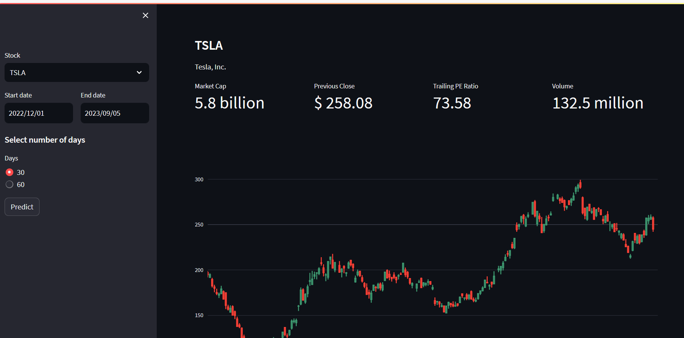

Slide 14


